Slide 1
Introduction to Data Science 1

Slide 2
Data Analysis
Pattern Recognition
Data Mining
Machine Learning

Slide 3
Data Analysis
the basics
DATA ANALYSIS IS
ABOUT PREDICTION
or
ABOUT RECOGNISING PREVIOUSLY UNSEEN THINGS

Slide 4
2 types of prediction
CLASSIFICATION
REGRESSION

Slide 5

CLASSIFICATION
DOG/NO DOG?

Slide 6
DOG/CAT?

Slide 7
REGRESSION
AGE?

Slide 8
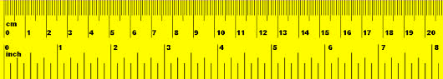
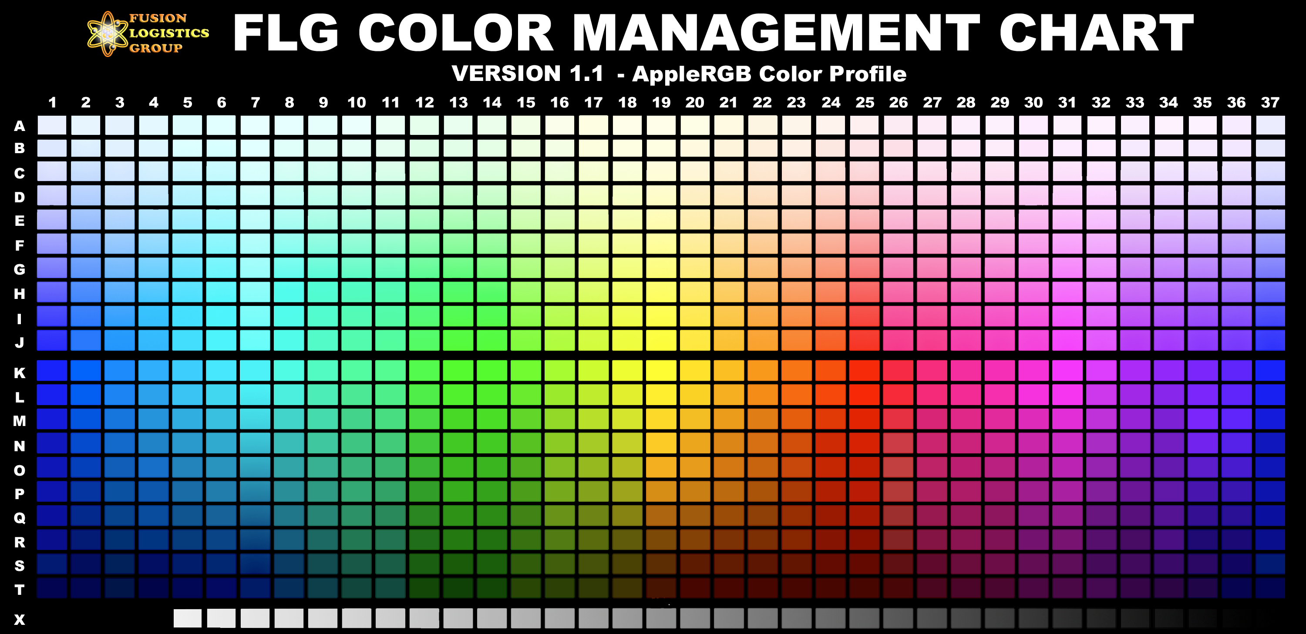
Data Analysis
concepts
instances
labels
features
feature values
feature vector
“Popov”
“dog”
“3 years”
color
height
furriness
“wit”
“0.3m”
“high”
(“wit”, “0.3m”, “high”)

Slide 9


Correlation
Popov
cuteness
furriness

Slide 10
Correlation
furriness predicts cuteness
correlation allows for prediction

Slide 11
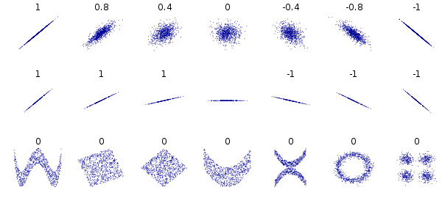
Pearson’s correlation coefficient
a.k.a. “Pearson’s r”

Slide 12

Background: Big Data, the impact on Science
THE END OF THEORY
Will the Data Deluge Makes the Scientific Method Obsolete? [6.30.08]
By Chris Anderson

Slide 13

(Big) Data Analysis

Slide 14


Slide 15
Data sets
Feature values are continuous
e.g., 0.1, 0.3, 0.4, 0.2, 0.7, …
Feature values are discrete
e.g., yes, no, male, small, …
Toy versus realistic datasets

Slide 16
contact lenses (toy) dataset

Slide 17
Complete description in terms of rules

Slide 18
Decision Tree

Slide 19
Description versus generalisation
The rules or decision tree provide a (complete) description of the contact lenses dataset. (A kind of summary.)
Depending on their structure, they may also generalise to novel cases (i.e., cases not included in the contact lenses dataset.

Slide 20
Prediction with
Data Mining
What is the goal?
What are meaningful features?
How can feature values be obtained?

Slide 21
Data Science tools
WEKA
Orange
Python
R

Slide 22
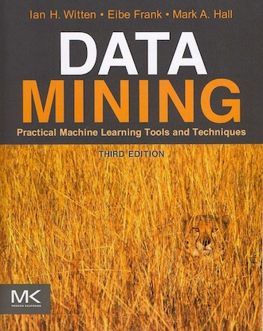
WEKA book

Slide 23
Why WEKA?
Data Scientists work with (a.o.):
R (statisticians) or
Python (computer scientists)
WEKA and Orange are for beginners

